Slide 1
Our original questions:
How can we make people more willing to follow female leaders?
Would providing a clear role model for “following women” help?
Spoiler alert—new questions!
Does a female leadership penalty really exist?
If so, might it arise from different impression processes for male and female leaders?

Slide 2
Women in leadership
Potential or actual female (vs. male) leaders are experience backlash due to:
Cultural mismatch between female gender role (i.e., communal qualities) and demands of leadership position (i.e., agentic qualities) (Role Incongruity Theory; Eagly & Karau, 2002)
Cultural masculinity of leader stereotypes (Think-Manager-Think-Male; Koenig, Eagly, Mitchell & Ristikari, 2011)
Female (vs. male) leaders are more likely to face:
Sabotage (i.e., male dominance) (Rudman, Moss-Racusin, Phelan, & Nauts, 2011).
Open and explicit criticism (Ely, 1994)
Undermining by their subordinates (Heim, 1990)
Male leaders show only small advantage over female leaders in terms of evaluations. The difference is exacerbated when female leaders:
Lead in stereotypically masculine leadership style (Eagly et al., 1992)
Exhibit anger (Brescoll & Uhlamnn, 2008; Fischbach, Lichetenthaler, &Horstmann, 2015)
Use intimidation strategies (Bolino & Turley, 2003)
Deliver discipline (Atwater, Carey, & Waldman, 2001)
Criticize subrodinates (Sinclair & Kunda, 2000)
Are seen as insufficiently communal (Heilman & Okimoto, 2007)
Notes:
Rudman et al., 2011 – lab study where female leaders were fed wrong words in game so that they would lose
Heim (1990) – nurses were less likely to follow female doctors’ orders than male ones
Ely (1994) – study of law firm partners. Junior female lawyers were more likely to criticize female law partners than male ones
also:
Butler & Geis, 1990: female leaders elicited more negative nonverbal affect and fewer positive responses than male leaders offering the same initiatives. Real groups.

Slide 3
What has been measured?
Nonverbal responses toward M/F leaders
Ratings:
Competence: expertise, effort, productivity, general evaluation
Satisfaction with leader: likability, desire to work with leader, group cohesiveness
Leadership style: interpersonal orientation, task orientation, potency, no style
Performance, Effectiveness
Performance appraisals in actual work settings
Notes:
Our original interest: WILLINGNESS TO FOLLOW

Slide 4

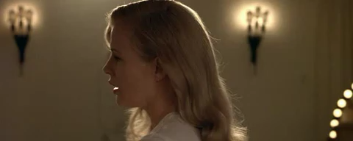
Prior studies – Study 1 (video study)
Control: Read scenario only
All conditions read scenario: Imagine that you got a new job. You are very excited about it - it fits well with your skillset and your expertise, so you know you will do great. Your first morning in the office you meet your direct manager – Sarah (David).
Notes:
video conditions: sexy, helpless, motherly, heroic, one of the guys, bossy

Slide 5
Measures
Followership:
I fully trust this person would lead us in the best direction.
I am confident this person would do what is best for us.
I would be willing to drop everything if this person needed my help.
Even if I wasn’t sure about it myself, I would support whatever this person decided we should do.
This person knows better than I do.
I would willingly follow this person.
“Active” following
“Passive” following
Trust
Trait ratings (warmth, competence)
Hostile, benevolent sexism
Notes:
Active
I would voice my opinion to this person, but only when asked.
I would offer my opinions whenever this person asked for them.
I’d be willing to challenge this person’s ideas in order to improve them, but only if they asked me to do so.
If and only if this person wanted my input, I would be eager to give it.
Passive
I would accept whatever this person says, without argument.
The best response would be to obey this person promptly.
It is important for me to do what this person wants, the way they want it.
I would blindly follow this person.
If this person says, “Jump!” I say, “How high?”
This question is just here to check your attention. Please answer (4) Neutral for this question.
Trust in leader
Robinson, S. L., & Rousseau, D. M. (1994). Violating the psychological contract: Not the exception but the norm. Journal of organizational behavior, 15(3), 245-259. (1539 citations)
(1 = strongly disagree, 5 = strongly agree)
I am not sure I fully trust my employer (reverse score).
My employer is open and upfront with me.
I believe my employer has high integrity.
In general, I believe my employer’s motives and intentions are good.
My employer is not always honest and truthful (reverse score).
I don’t think my employer treats me fairly (reverse score).
I can expect my employer to treat me in a consistent and predictable fashion.

Slide 6
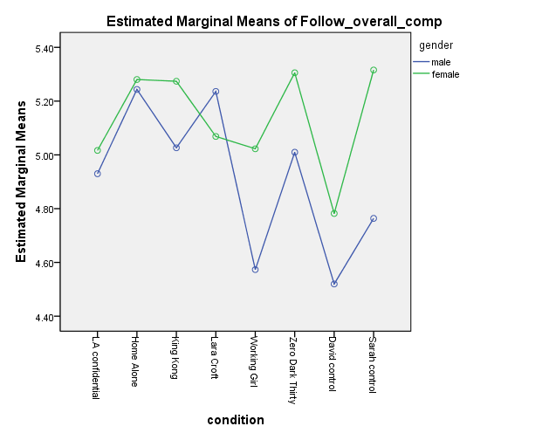
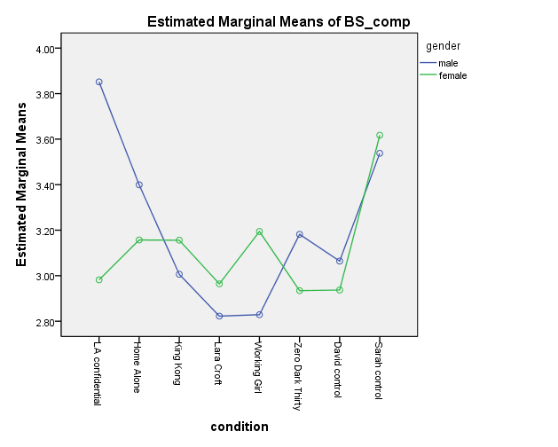
Some of the findings
Notes:
Basically, the patterns were erratic, the control conditions were generally as good as any video conditions, and S > D.

Slide 7
Study 2 – new control conditions
Imagine that you got a new job. You are very excited about it; you've wanted this particular job for a long time. You have not met your boss, but when you walk in, the HR rep introduces you. Your new direct manager is a woman named Sarah. From talking to your friend who works at this company, you know that Sarah has high standards and demands only the best from those who work for her - something that makes her own boss very happy. Occasionally though, that comes at the expense of not being very patient with her subordinates who do not meet these high standards.
Follower ratings:
Sarah M = 4.30, sd = 1.31
David M = 4.16, sd = 1.38
but crossover: men follow Sarah more,
women follow David more

Slide 8
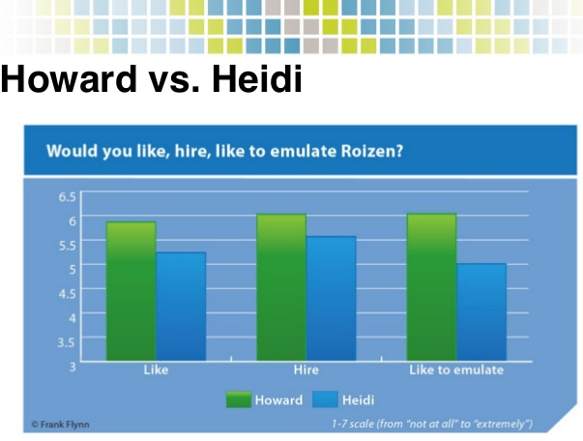
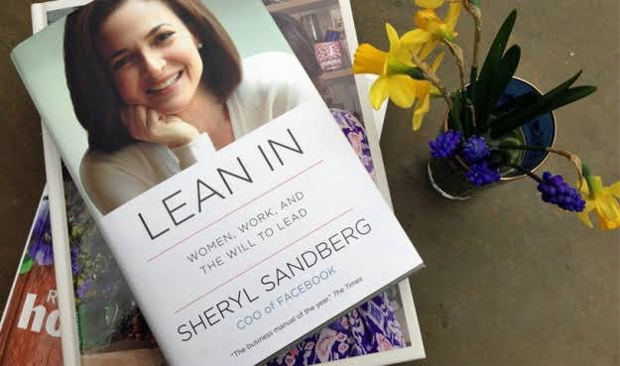
Study 3 – Heidi/Howard Roizen case

Slide 9
Study 3 – Heidi/Howard Roizen case
Measures from before us:
Heidi less warm, likable
Heidi more aggressive, power hungry
Neither difference is significant
Our follower measure:
Greater willingness to follow Heidi on all measures
But nonsignificantly so
Study run twice, once with Mturk (results above) and once with MBA students (key finding: 3-way interaction of gender condition, rater gender, and hostile sexism: Gender, HS didn’t affect desire to follow Howard. But men high in HS were significantly less likely to follow Heidi and women high in HS significantly more likely.

Slide 10
Study 4 – “pushback”
Similar to Study 2, but:
After you have been working in this company for about a month, Sarah (David) gives you a new assignment and very specific instructions for how to do it. You are surprised at the instructions because you know of a better way of accomplishing that task, so you bring that up to Sarah. She scoffs at you, tells she knows better, and firmly tells you to proceed with instructions she originally provided.” You don’t have strong feelings about the instructions one way or the other, so you let Sarah know that you will do it. Sarah nods in agreement and tells you that she really thinks the instructions she provided would be the best way to accomplish the task.
Willingness to follow:
 | Pushback | No Pushback
David | 2.92 (1.29) | 4.33 (1.48)
Sarah | 3.16 (1.31) | 4.68 (0.78)
 | Percentage of Respondents
Prefer male boss | 24.5
Prefer female boss | 13.3
No preference | 62.2
Notes:
Imagine that you got a new job. You are very excited about it; you've wanted this particular job for a long time. You have not met your boss, but when you walk in, the HR rep introduces you. Your new direct manager is a man named David. From talking to your friend who works at this company, you know that David is very determined - he does not give up on a project when complications arise and works relentlessly to solve difficult problems. Unfortunately, he is not very understanding - he does not really encourage employees to approach him if a problem arises and does not listen when subordinates are having a personal conflict. After you have been working in this company for about a month, David gives you a new assignment and very specific instructions for how to do it. You don’t have strong feelings about the instructions one way or the other, so you let David know that you will do it. David nods in agreement and tells you that he really thinks the instructions he provided would be the best way to accomplish the task.
After you have been working in this company for about a month, Sarah gives you a new assignment and very specific instructions for how to do it. You are surprised at the instructions because you know of a better way of accomplishing that task, so you bring that up to Sarah. She scoffs at you, tells she knows better and firmly tells you to proceed with instructions she originally provided.”

Slide 11
BUT…
Haslam & Ryan: women seen as better leaders under normal, non-crisis conditions.
Eagly: women associated more with transformational leadership styles, which are generally seen positively.

Slide 12
So, our new idea…
Maybe people’s impressions of women are generally positive, but then they react badly to particular things women do
Looking across multiple behaviours can let us observe how impressions form—differently for men, women?
Notes:
Many studies that showed people viewing female leaders negatively look at only one behavior; mistakes less easily forgiven for female—but not realistic bc we don’t judge a person on basis of one behavior

Slide 13
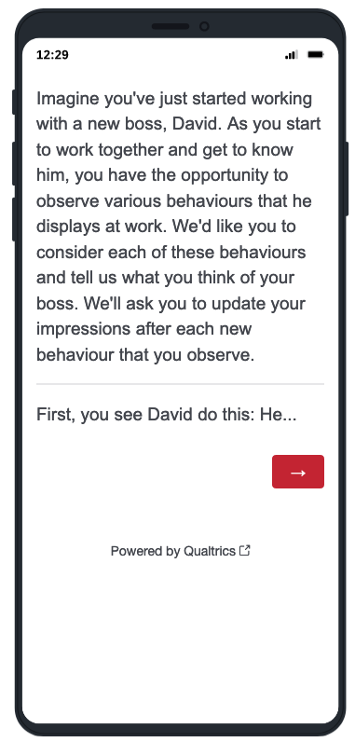
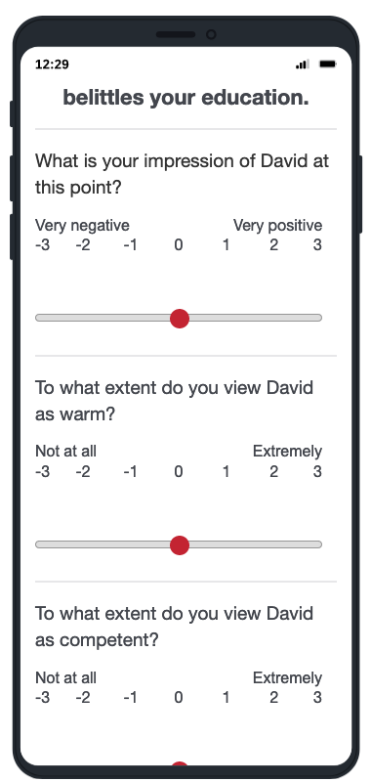
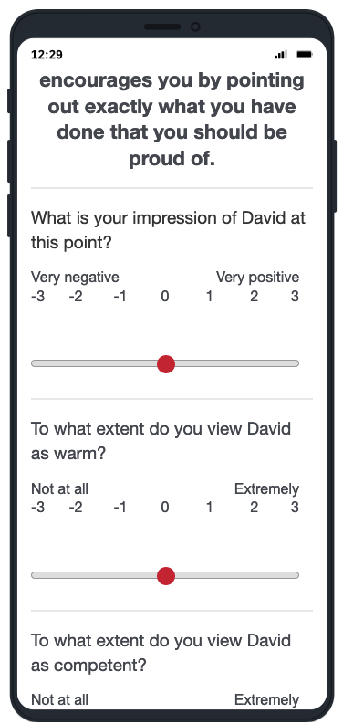
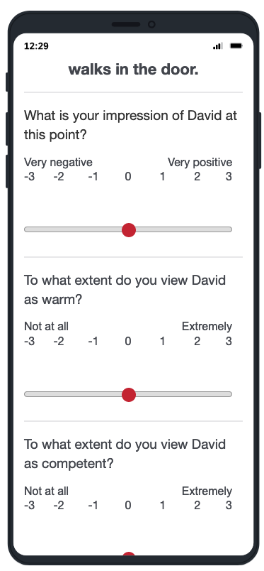
Design

Slide 14
Analysis Model (heavily simplified)
Target Gender
IMPR_{T-1}
IMPR_{T}
WARM_{T-1}
WARM_{T}
COMP_{T-1}
COMP_{T}
BEH VALENCE
Notes:
This depicts a straight multilevel model, but the model is really cross-classified. That means we should be superimposing latent factors for within variance due to rounds and between variance due to person. Target gender is manipulated between persons and behaviour valence is within person, varying from round to round, and the order of presentation of behaviours is random.

Slide 15
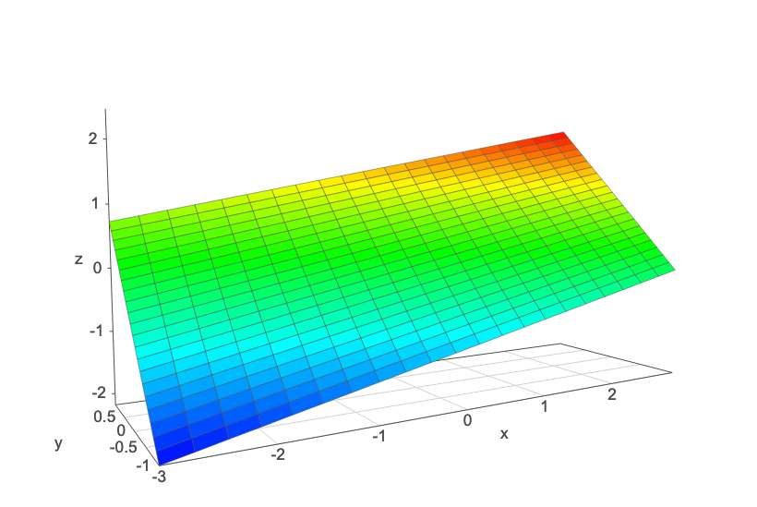
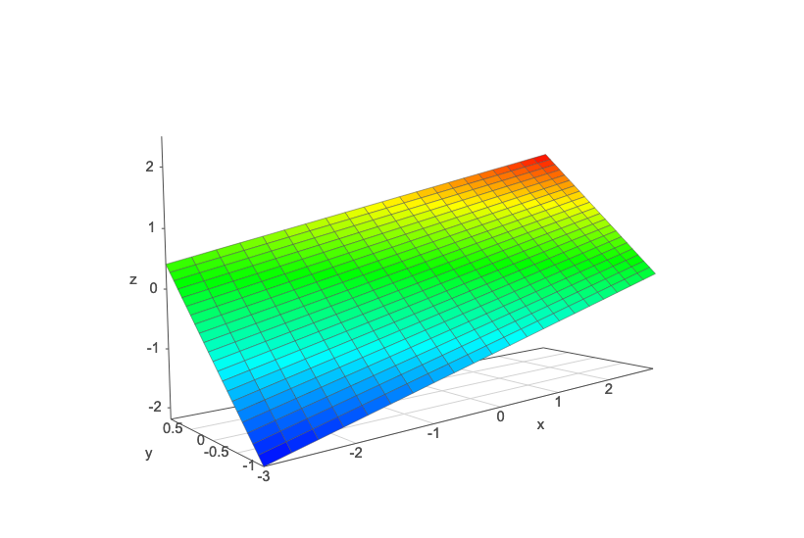
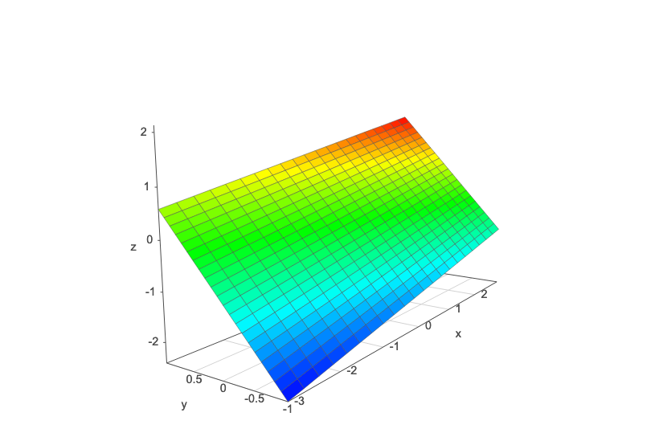
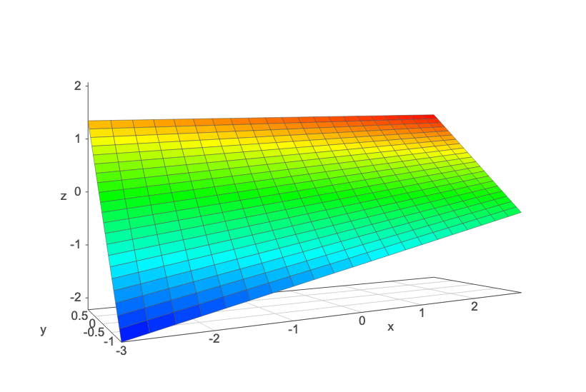
Study 1: Student sample (Italy)
Study 1: Prolific sample (UK)
Mean Impr: .155*( )
impr->impr: .305*(*)
behval->impr: 1.406*( )
inter->impr: -.016*(*)
Mean Impr: .184*( )
impr->impr: .374*(⁺)
behval->impr: 1.318*(⁺)
inter->impr: .012 ( )
Sarah
Mean Impr: .188*( )
impr->impr: .209*(*)
behval->impr: 1.520*( )
inter->impr: -.088*(*)
Mean Impr: -.088 (*)
impr->impr: .286*(⁺)
behval->impr: 1.527*(⁺)
inter->impr: .034⁺( )
David
x: previous impression (impr)
y: behaviour valence (behval)
z: interaction w/lagged behaviour valence (inter)
* = significant at p < .05
⁺ = marginally significant
first * is parameter significance; ( ) for S/D difference

Slide 16
Supplementary analysis:
Time | Beh Val | Impr
1 | + | 4
2 | 0 | 4
3 | 0 | 4
4 | - | 3.7
5 | - | 3.4
… | … | …
40 | - | 5.2
Do people anchor on the initial behaviour they see and that carries through their impression?
If so, does that differ for M (-) vs F (+) targets?
IMPR_{T40} = Gender*BehVal_{T1}:
b = .27, F(1, 199) = 3.09, p = .080
Perceivers are somewhat more likely to anchor their final impression on
the first behaviour they saw for female, vs. male, targets.

Slide 17
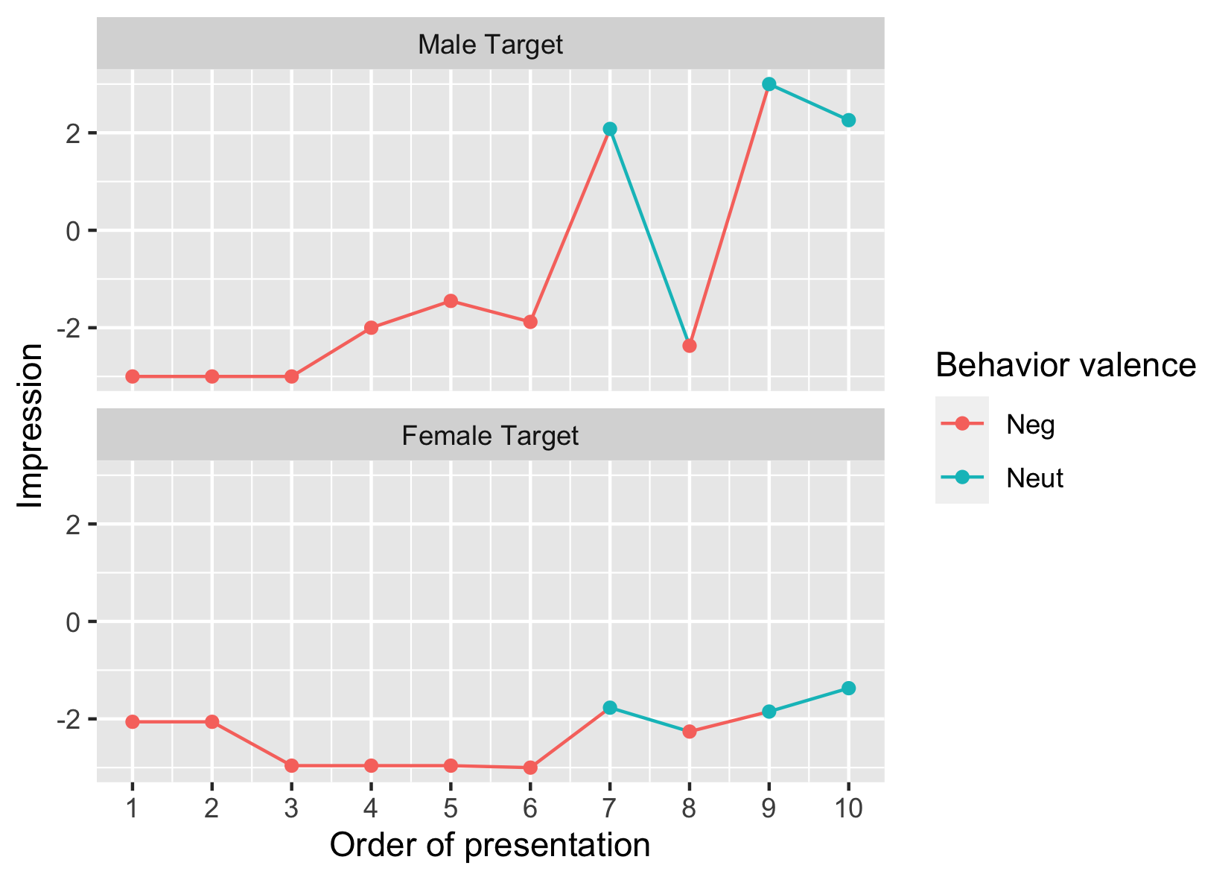
Notes:
group 1

Slide 18
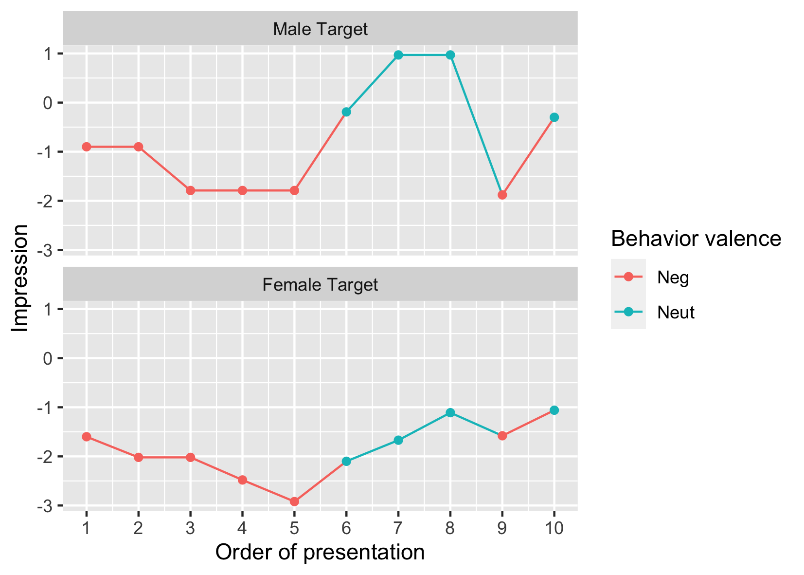
Notes:
group 8

Slide 19
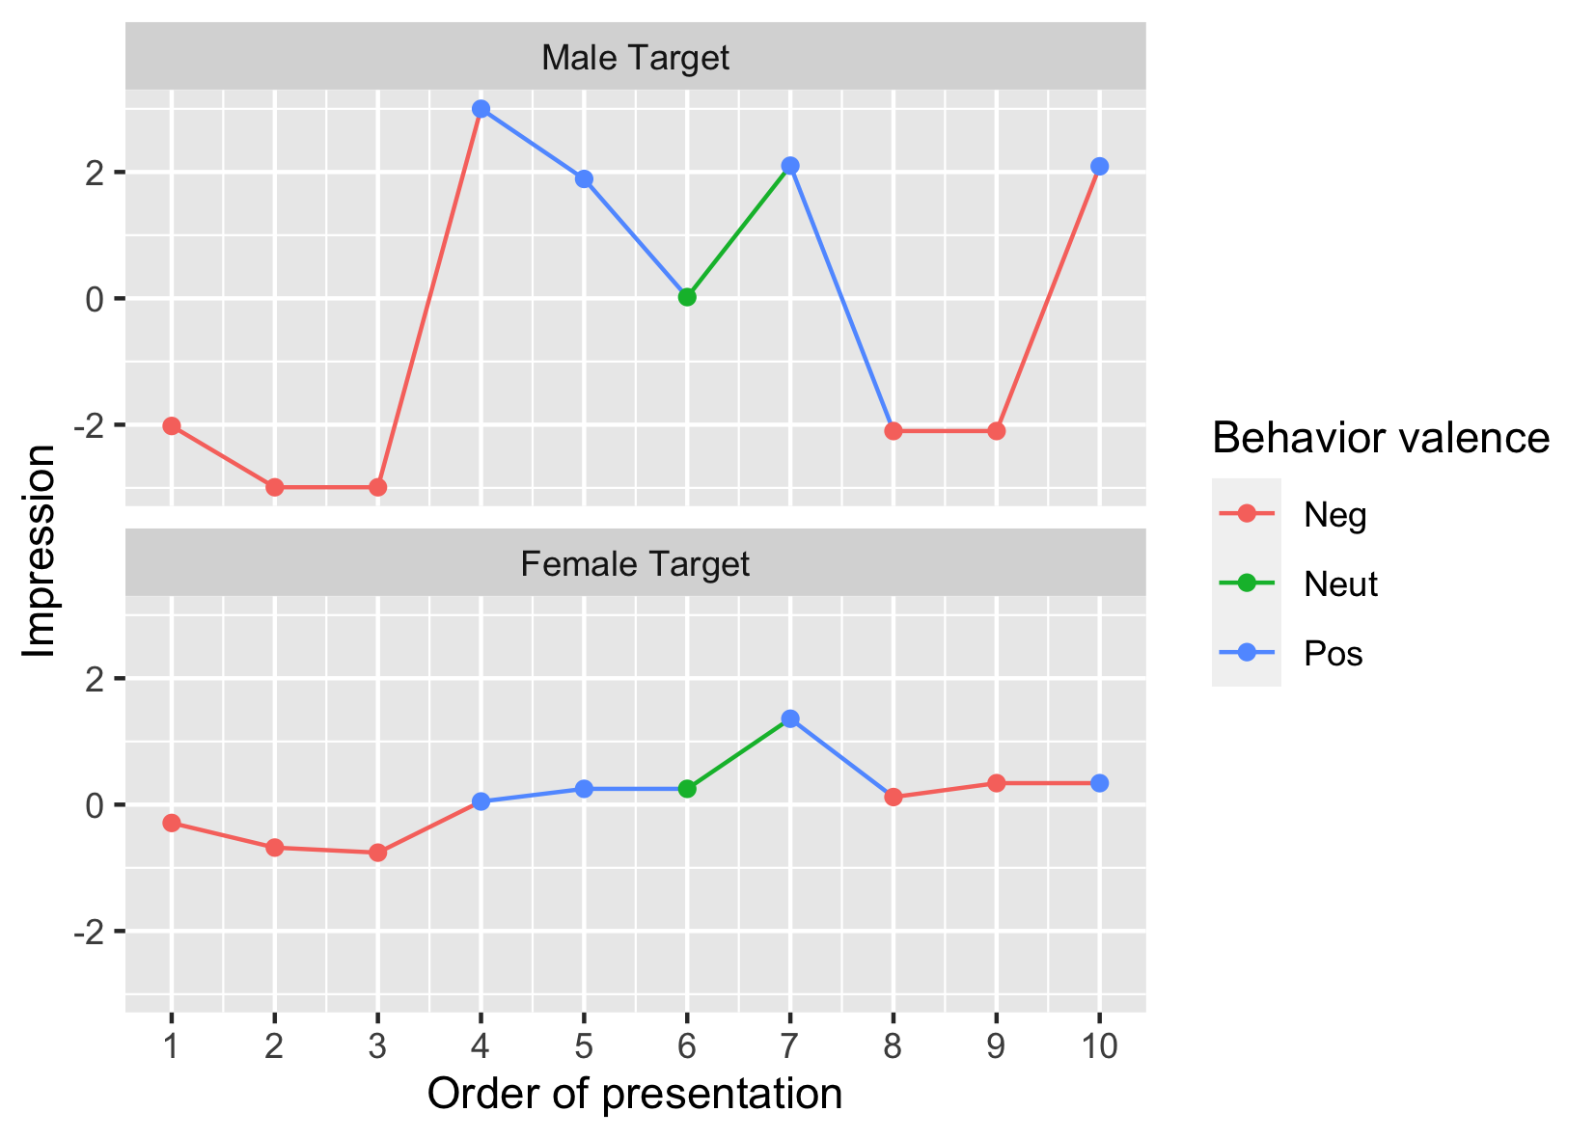
Notes:
group 37

Slide 20
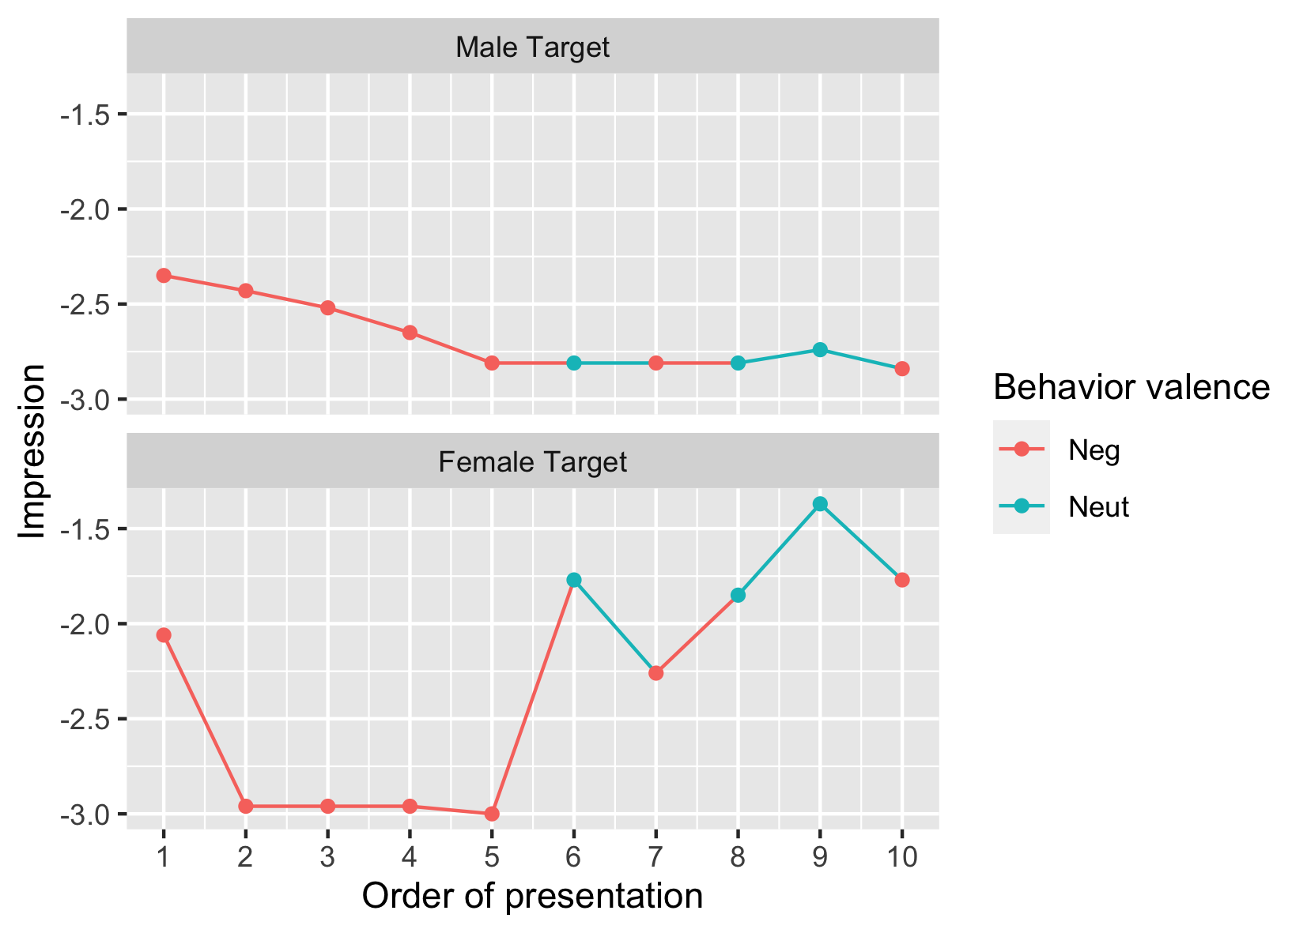
Notes:
group 3

Slide 21
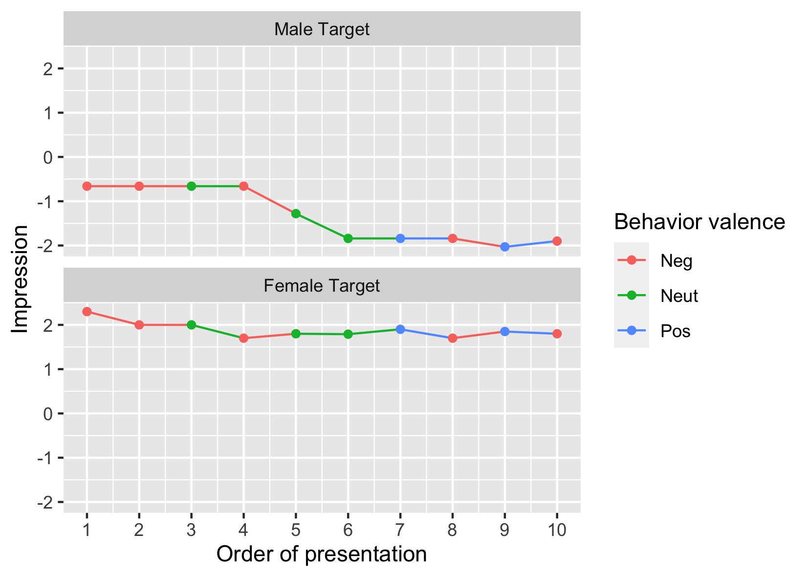
Notes:
group 3

Slide 22
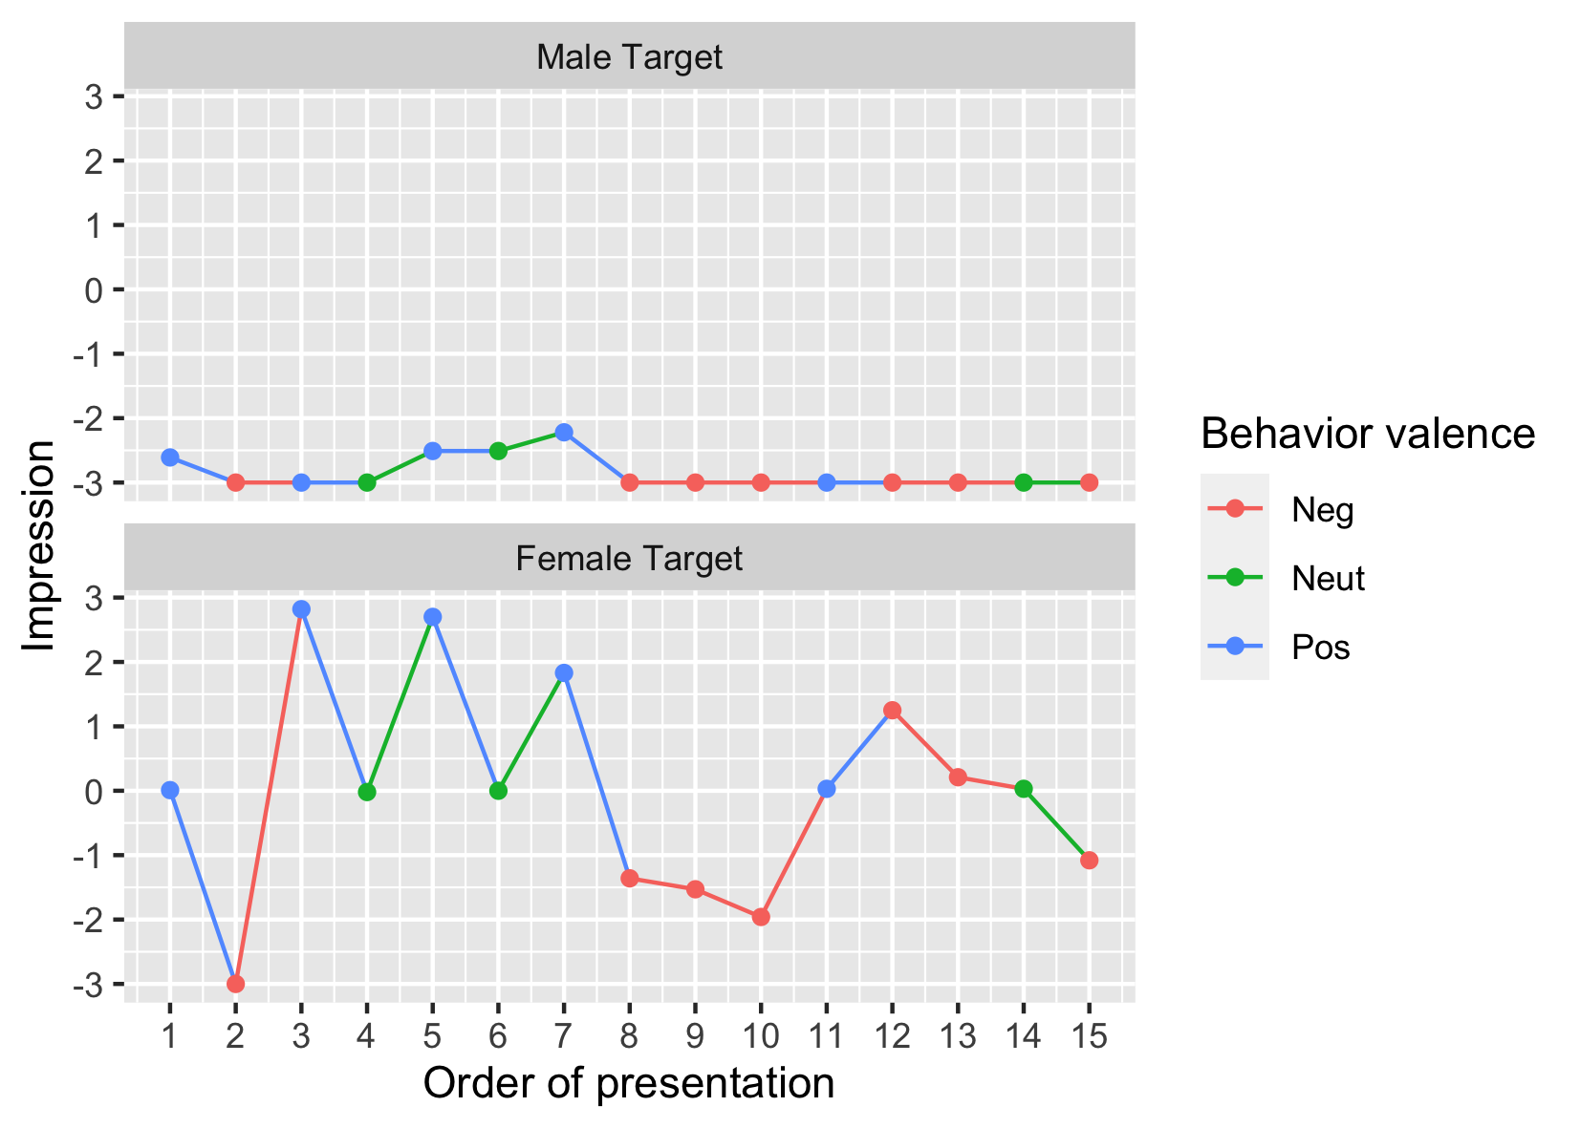
Notes:
group 3

Slide 23
Study 1: Student sample (Italy)
Study 1: Prolific sample (UK)
Mean Impr: .155*( )
impr->impr: .305*(*)
behval->impr: 1.406*( )
inter->impr: -.016*(*)
Mean Impr: .184*( )
impr->impr: .374*(⁺)
behval->impr: 1.318*(⁺)
inter->impr: .012 ( )
Sarah
Mean Impr: .188*( )
impr->impr: .209*(*)
behval->impr: 1.520*( )
inter->impr: -.088*(*)
Mean Impr: -.088 (*)
impr->impr: .286*(⁺)
behval->impr: 1.527*(⁺)
inter->impr: .034⁺( )
David
x: previous impression (impr)
y: behaviour valence (behval)
z: interaction w/lagged behaviour valence (inter)
* = significant at p < .05
⁺ = marginally significant
first * is parameter significance; ( ) for S/D difference

